Slide 1
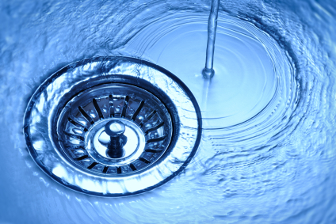

Before you flush it or put it down the drain . . .

Slide 2
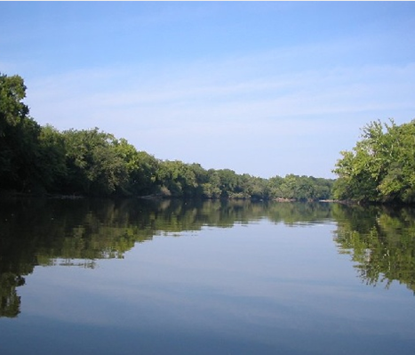
think about how it could end up in our environment.
Our sewage collection system, made up of pump stations, lines and treatment facilities, was designed to treat and process human waste, gray water (from showers and other washing) and toilet tissue.
Other materials , like fat / oil / grease, sanitary items, and non-biodegradable ’flushable’ items can lead to big problems including sewer backups in your home or sewer system overflows that end up in our storm drains and water bodies.

Slide 3
What are the risks?
Domestic sewage pipes are typically only 4 inches in diameter, and when these pipes are misused, the result can be sewer blockages that reduce the efficiency of the system and add to the problem of sewage outflow from the system.
This type of situation can put many homes at risk for sewage flooding, and at risk for polluting our local waters.

Slide 4
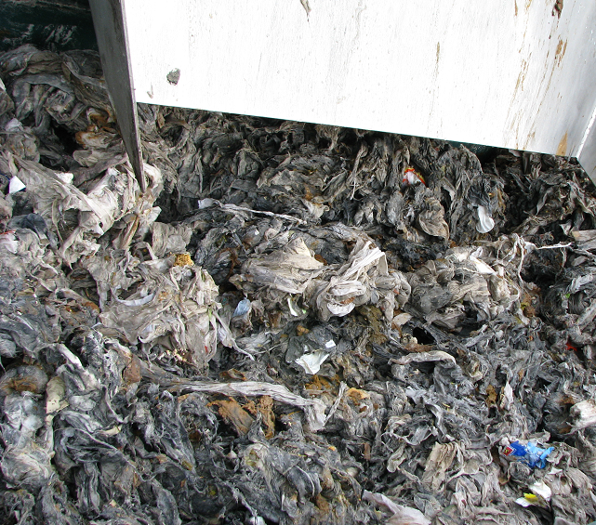
Sewage flooding presents a health risk to humans and wildlife, as well as looking unsightly.
When drains and sewers are misused this way, we all pay the price for cleaning the sewers, removal of blockages and cleaning up the rivers, homes and land affected by sewer flooding.
Paper products and wipes filtered out of a wastewater pump station.

Slide 5
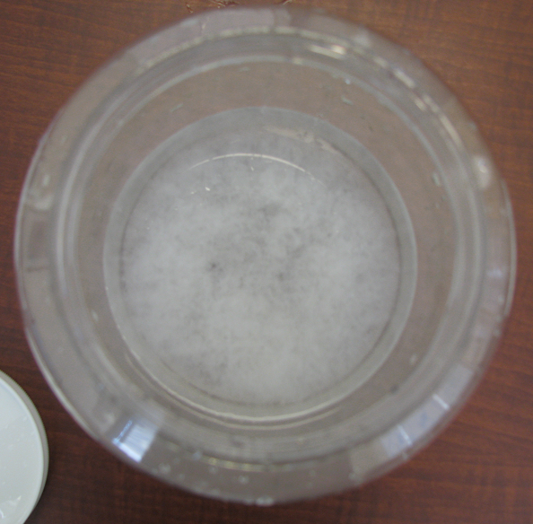
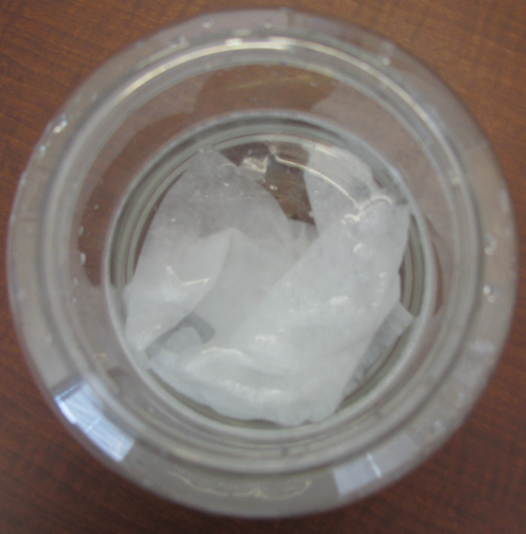
To flush or not to flush?
It says flushable on the box, so why shouldn’t you put it in the toilet?
“Flushable” means just that, it can go down the toilet. But once it’s out of sight, that’s when the trouble begins.
The only things appropriate to put in the toilet are toilet paper and human waste. Other things just don’t break down as they should. This first picture shows toilet paper that immediately dissolves. The wipes in the bottom picture still hadn’t even begun to break down after four days.

Slide 6
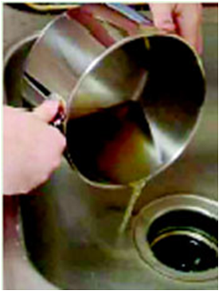
Food for thought . . .
And food byproducts. Did you know that most fat that is poured down the drain is in liquid form, but when it hits the cold pipes underground, it tends to harden on the walls of the pipes as it moves through.
A popular myth is that running hot water down the drain will prevent this from occurring, but the ground surrounding the pipe keeps it cool, allowing the fat to cling to the walls of the pipe.

Slide 7
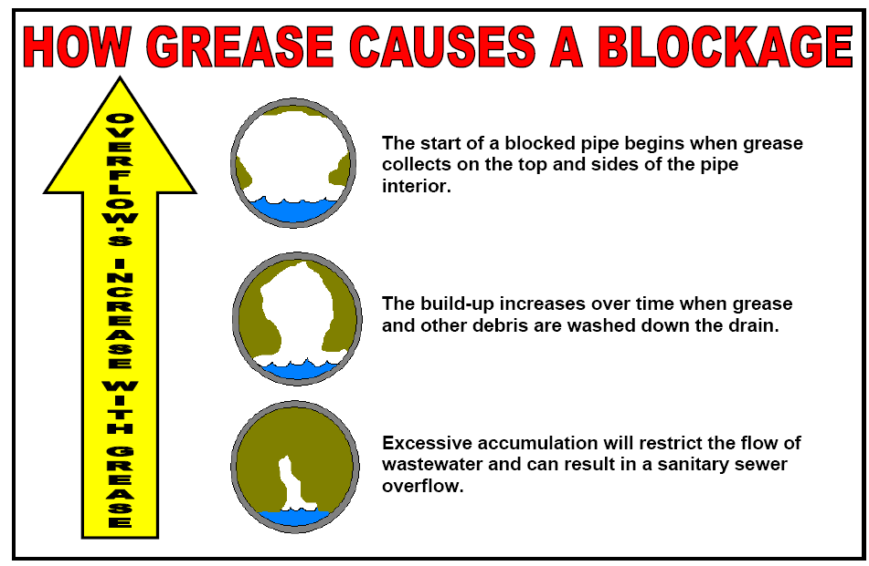

Slide 8
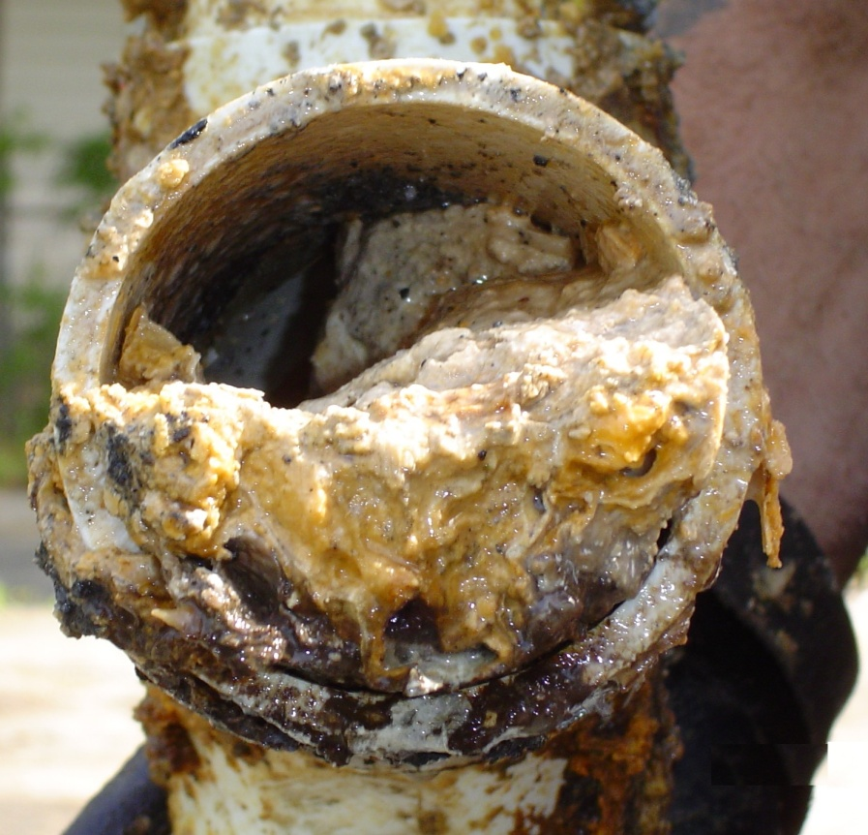
Over a period of weeks or months, the fat hardens within the pipes, eventually causing the pipe to become completely blocked. Sometimes, these blockages can cause sewage to discharge into a river or stream, which is a threat to our environment.
You can help prevent these sewage floods by disposing of sanitary napkins, diapers, grease and fat with your local waste collection facility and not into drains or flushed down commodes.

Slide 9
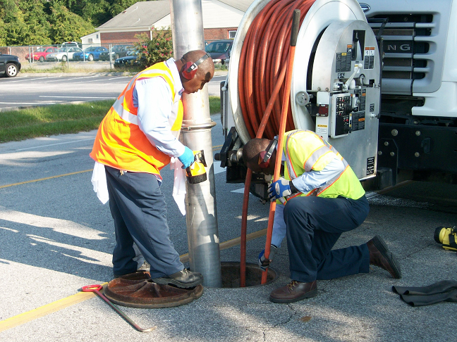
Aggressive outreach, cleaning and maintenance is required to try to avoid costly sewer system overflows caused by backups caused by grease and other materials introduced into the sewer collection system.

Slide 10
Proper Disposal
Cooking Fat:
Allow the fat to cool and solidify, then scrape it out, wrap it in newspaper or tin foil and dispose of it in your trash bin. Alternatively, pour it into a plastic container and when it has cooled dispose of it in your trash bin.
Sanitary napkins, tampons and panty liners:
Wrap item well and dispose of them in your trash bin. Special disposal bags are available at some pharmacies and supermarkets. In public restrooms, please place items in the sanitary bins provided.
Condoms and used bandages:
Wrap items well and dispose of them in your trash bin.
Diapers, liners and wipes:
Dispose of in your trash bin. Wrap diapers and liners.
Diaper disposal bags are available at supermarkets and pharmacies.

Slide 11
Razor blades:
To avoid injury, place used blades in a solid container before putting them in the trash bin.
Medicines:
Check with your local pharmacy to see if they take back unused medicines or contact your local law enforcement center or hospital to find out when the next drug take back day is scheduled.
Used syringes and needles:
Needles and syringes must be packaged in a container that is rigid, leak-proof when in an upright position and puncture resistant. The package then may be disposed of with general solid waste.
Other liquids like gasoline, antifreeze, solvents, etc.
Contact WASTEC at (910) 798-4400 to find out when the next household hazardous waste collection day will be held.

Slide 12
Do not flush:
Sanitary napkins
Disposable diapers
Liners
Baby / Cleaning wipes
Cleaning products
Razors
Contraception
Cotton balls, Q-tips
Toothbrushes
Contact lenses
Paper towels
Grease, kitchen fat
Colostomy bags
Bandages
Syringes, needles
Medicines
Toys
Clothing
Dental floss
Cigarette butts
Shop towels
Paint

Slide 13

For more information, contact Community Compliance at 332-6558 or visit our web at www.cfpua.org
It is CFPUA’s mission to provide high-quality water
and sewer service
in an environmentally responsible manner,
while maintaining the lowest practicable cost.

